Slide 1
Software Project Management
(4)
Du Yugen
ygdu@sei.ecnu.edu.cn
Roger Du@SEI of ECNU

Slide 2
Chapter 4
Selection of An Appropriate Project Approach
Roger Du@SEI of ECNU

Slide 3
OBJECTIVES
When you have completed this chapter you will be able to:
Take account of the characteristics of the system to be developed when planning a project;考虑待开发系统的特征
Select an appropriate process model;选择合适的过程模型
Make best use of the waterfall process model where appropriate;最佳利用瀑布过程模型
Reduce risks by the creation of appropriate prototypes;创建合适的原型来降低风险
Reduce other risks by implementing the project in increments.用增量方式推行项目以降低其他风险
把通过敏捷开发(Agile Development)可以消除的那些不必要的组织级障碍情形加以标识
Roger Du@SEI of ECNU

Slide 4
4.1 introduction
内部开发的软件项目的特征
项目组和用户属于同一个组织
在考虑做的项目嵌入(slot)到现存计算机系统的组合中
要使用的方法和技术不是由项目经理来选择的,而是由局部标准(Local standard)规定的
但是软件公司为外部客户开发的项目, 必须根据每个项目来决定使用的方法和技术。这种决策过程有人已经称为“技术策划”（technical planning），尽管这里使用术语“项目分析”（project analysis）
Roger Du@SEI of ECNU

Slide 5
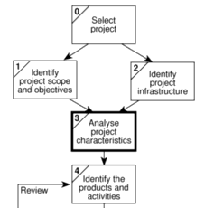
The relevant part of the step wise approach is Step 3
Roger Du@SEI of ECNU

Slide 6
4.2 choosing technologies选择技术
与产品和活动一样,选择的技术将影响一个项目以下方面：
  开发人员的培训需求
  要招聘的人员的类型
  开发环境——硬件和软件
  系统维护安排
Roger Du@SEI of ECNU

Slide 7
步骤：
分析项目是目标驱动的还是产品驱动的
分析项目其他特征
  面向数据(data-oriented),如IS,还是面向过程控制(process-oriented),如ES
  通用工具，如EXCEL，还是专用工具，航空公司座位预定系统
  是否涉及需要专用工具支持的专门技术
    如并发处理
    基于知识的系统,如专家系统
  是否有特殊的安全性要求
    如系统故障危及人身安全的
  系统所需软硬件环境特性是什么
Roger Du@SEI of ECNU

Slide 8
练习
对下列系统进行分类
  工资支付系统
  饮料灌装企业的控制系统
  供水企业管理对企业供水计划的系统
  支持项目管理的软件
  供律师查询法律条文的系统
Roger Du@SEI of ECNU

Slide 9
参考答案
面向数据或特定领域的应用系统
包含嵌入式软件的过程控制或者工业系统
使用图形的信息系统
通用信息系统软件包
信息收集的通用软件包
Roger Du@SEI of ECNU

Slide 10
识别高层的项目风险
产品不确定性：系统需求理解的准确性。用户在开始时有可能对系统应该什么样都无法确定。在某些环境中，精确而有效的需求描述可能迅速变得过时。
过程不确定性：在项目开始时需要选择方法或过程模型，或者一种新的工具，任何对原先采用的开发方法的变化都将引入不确定性
资源不确定性：项目进行中资源的数量可能发生变化
Roger Du@SEI of ECNU

Slide 11
练习
识别学院工资系统中的风险
  财务和人事职员之间的矛盾
  人事职员对系统不接受
  缺少运行该系统的经验
  缺少管理系统的计算机专业人员
  需求变化
Roger Du@SEI of ECNU

Slide 12
选择方法
考虑用户关于实现的需求
  用户可能在合同中限定了有关实现方面的方法。例如，规定了企业必须具有相应的CMM等级，或者通过了ISO9000方法
选择通用的生命周期方法
  控制系统：一般为实时系统，比如实时系统的并发处理会用到象Petri网这样一来的技术
  信息系统：
  通用工具
  专用工具
  硬件环境
  安全相关的系统
  不准确的需求（imprecise requirement)
Roger Du@SEI of ECNU

Slide 13
技术计划内容清单
技术计划可能包括：
1.约束条件的介绍和总结
a）待开发系统的特征
b）项目的风险和不确定性
c）关系到实行的用户需求
2.推荐的方法
a）选择方法或过程模型
b）开发的方法
c）需要的软件工具
d）用到的软硬件环境
3.实现
  a）要求的开发环境
  b）要求的维护环境
  c）要求的培训
4.牵涉的问题
  a）项目的产品和活动-这些会影响项目进度和总的项目效果
  b）财务的-这个报告将用来得到成本
Roger Du@SEI of ECNU

Slide 14
Too often, software work follows the first law of bicycling: No matter where you’re going, it’s uphill and against the wind
通常地，软件工作遵守骑车第一法则：无论你往哪里，都是上坡且逆风而行。
Roger Du@SEI of ECNU

Slide 15
4.4过程模型的选择process models
过程process：相关联的一项或多项活动开发一个软件需要选择开发策略（包括过程，方法和工具）以及通用阶段，这些策略和阶段被称为过程模型
过程模型的选择基于项目和应用的特性，使用的工具和方法，所需要的控制方法和交付物。
Roger Du@SEI of ECNU

Slide 16
软件过程的概念
软件过程由关于项目的阶段、状态、方法、技术和开发、维护软件的人员以及相关对象（计划、文档、模型、编码、测试、手册等）组成。
一个过程定义了为达到某个确定的目标，需要什么人在什么时间以何种方式做何种工作
软件需要一个可用于指导顾客、用户、开发人员和项目经理等参与者的过程
Roger Du@SEI of ECNU

Slide 17
软件开发过程
软件工程的核心是过程。产品、人员、技术通过过程关联起来。软件开发过程能够将技术集成在一起从而使软件的开发能够以一种合理而及时的方式完成。
产品
客户
特性
业务
条件
过程
人员
开发
环境
技术
Roger Du@SEI of ECNU

Slide 18
有效的软件过程
有效的软件过程可以提高组织的生产能力
  保证软件开发的基本原则的实现，辅助软件项目管理者作出明智的决定；
  使软件开发活动标准化，提高软件的可重用性和Team间的协作；
有效的软件过程也可以改善软件组织对软件的维护能力
  通过有效地定义如何管理需求变更，使得变更部分能够在未来的版本中恰当分配，实现平滑过渡；
  在具体操作和相关支持中定义如何平滑地改造软件，并且这种具体操作和支持是可实施的；不可实施的软件过程被剔除。
Roger Du@SEI of ECNU

Slide 19
问题求解的一般过程
问题求解的一般过程
  实际问题并不能简单划为四个阶段，各个阶段会在问题的不同层次上同时并存
  软件开发实际上是一个“混沌”（chaos）过程（Raccoon）
问题定义
现状
技术开发
方案集成
Roger Du@SEI of ECNU

Slide 20



4.5编码修正模型
Code and Fix
Code like Hell(鲁莽编码)
从一个大致的想法开始工作，然后经过非正规的设计、编码、调试和测试方法，最后完成工作
可能有可能没有的规范
发布（可能）
Roger Du@SEI of ECNU

Slide 21
编码修正模型
好处：
  成本可能很低
  只需要很少的专业知识，任何写过程序的人都可以
  对于一些非常小的、开发完后就会很快丢弃的软件可以采用
对于规模稍大的项目，采用这种模型是很危险的
Roger Du@SEI of ECNU

Slide 22
4.6瀑布模型（Waterfall Model)
所有过程模型的祖宗
项目从开始到结束按照一定的顺序执行
瀑布模型是文档驱动的，各个阶段不连续也不交叉
Roger Du@SEI of ECNU

Slide 23
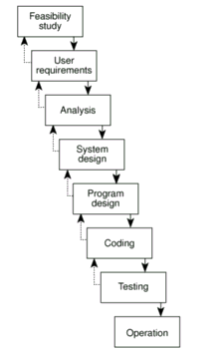
瀑布模型
瀑布模型适应于什么场合？有何优缺点？
Roger Du@SEI of ECNU

Slide 24
瀑布模型适合的场合
当有一个稳定的产品定义和很容易被理解的技术解决方案时，纯瀑布模型特别合适
当你对一个定义得很好的版本进行维护或将一个产品移植到一个新的平台上，瀑布模型也特别合适。
纯瀑布模型能够降低管理费用，因为你可以预先完成所有计划。
对于那些容易理解但很复杂的项目，采用纯瀑布模型比较合适，因为可以用顺序方法处理问题。
在质量需求高于成本需求和进度需求的时候，它尤为出色。
当开发队伍的技术力量比较弱或者缺乏经验时，瀑布模型更为适合。
Roger Du@SEI of ECNU

Slide 25
瀑布模型的缺点
纯瀑布模型的缺点是在项目开始的时候，在设计工作完成前和代码写出来前，很难充分描述需求。
瀑布模型最主要的问题是缺乏灵活性。必须在项目开始前说明全部需求。但这恰恰是非常困难的。
Roger Du@SEI of ECNU

Slide 26
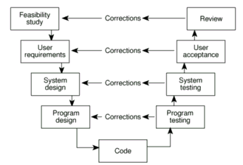
4.7瀑布模型变种：V型模型
该方法是对瀑布模型的修正，强调了验证活动
Roger Du@SEI of ECNU

Slide 27
4.8瀑布模型变种：生鱼片模型
把阶段重叠起来的瀑布模型
起源于日本硬件开发模型（富士通—施乐）
软件概念
需求分析
架构设计
详细设计
编码和调试
系统测试
Roger Du@SEI of ECNU

Slide 28
瀑布模型变种：生鱼片模型
传统的瀑布模型强调阶段之间最小的重叠，而生鱼片模型强调大幅度的重叠，即在需求分析完成之前就可以进行架构设计和部分详细设计
纯瀑布模型强调在任意两个阶段交接时，文档从一个团队交给另一个完全隔离的团队，但是如果一个团队完成各个阶段任务时，可以没有那么多文档。
问题：缺点是什么？
生鱼片模型因为阶段重叠，因而里程碑不明确，很难有效地进行过程跟踪和控制。
Roger Du@SEI of ECNU

Slide 29
瀑布模型变种：具有子项目的瀑布模型
纯瀑布模型的一个问题是必须完成全部的架构设计后才能进行详细设计，但是，整个系统中有些部分可能有些特殊性，可以有自己的步骤，即将这些部分划分为为子项目。
问题：该模型有何问题？
这种方法的主要风险是相关性无法预料。
Roger Du@SEI of ECNU

Slide 30
瀑布模型变种：能够降低风险的瀑布模型
纯瀑布模型要求在开始架构设计前，必须将用户的所有需求都搞清楚，但是实际中是很困难的。
可降低风险的瀑布模型是在顶端，即需求分析和架构设计阶段引入螺旋以便降低风险。
在该螺旋中，先开发一个用户界面原型，采用系统情节串联图版（system storyboarding）引导用户提出需求，记录用户与系统的交互操作方式，或者采用其它需求获取方法。
Roger Du@SEI of ECNU

Slide 31
4.9螺旋模型(Spiral model)
Spiral 模型（Boehm提出）
以风险为导向的生命期模型
从一个小范围的关键中心地带开始寻找风险因素，制定风险控制计划，并交付给下一步骤，如此迭代，每次迭代将项目扩展到一个更大的规模
Roger Du@SEI of ECNU

Slide 32
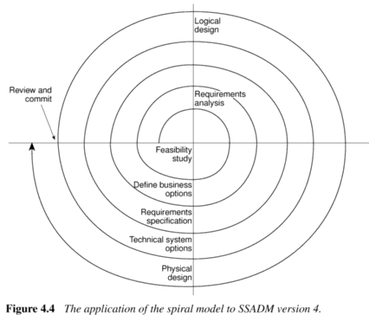
Spiral model to SSADM
Roger Du@SEI of ECNU

Slide 33
Cumulative cost
Progress through steps
Evaluate alternatives, identify, resolve risks
Determine objectives, alternatives, constrains
Risk analysis
Risk analysis
Risk analysis
Risk analy-sis
Prototype ₁
Prototype ₂
Prototype ₃
Operational prototype
Commitment
问题：有何优缺点？
Review
Partition
Requirements plan, life-cycle plan
Simulations, models, benchmarks
Concept of operation
Software requirements
Detailed design
Software product design
Develop-ment plan
Requirements validation
Unit test
Code
Integration and test plan
Design validation and verification
Integration and test
Plan next phases
Acceptance test
Implementation
Develop, verify next-level product
The spiral model
Roger Du@SEI of ECNU

Slide 34
螺旋模型优缺点
优势：随着迭代的增加（成本的增加），风险程度随之降低
缺陷：比较复杂，需要责任心，专注和管理方面的知识。
Roger Du@SEI of ECNU

Slide 35
WINWIN螺旋模型
在螺旋模型中，通过与客户的通信获取客户的需求，实际上，客户的需求与最终确定的需求是不一致的，客户与开发者之间需要进行协商，最终达到双赢的局面。
Boehm提出的WINWIN螺旋模型中，客户与开发者之间需要
  识别系统或子系统的干系人（stakeholders）
  确定干系人的“win conditions”
  对这些条件进行协商获得互赢条件
Roger Du@SEI of ECNU

Slide 36
WINWIN螺旋模型
WINWIN螺旋模型还引入了三个过程的里程碑，被称为定位点（Anchor points）
  生命周期目标（life cycle objectives）定义了每个主要活动的目标
  生命周期体系结构（life cycle architecture）定义了系统和软件的体系结构目标
  初步操作能力（initial operational capability）定义了软件安装，发布的目标。
Roger Du@SEI of ECNU

Slide 37
4.10并行开发模型concurrent development model
并行开发模型（concurrent development model）又被称为并行工程（concurrent engineering）（By Davis and Sitaram）
软件开发中的所有活动可能同时并存，但是都处于不同的状态中
并行开发模型定义了活动从一个状态转化为另一个状态的事件
Roger Du@SEI of ECNU

Slide 38
并行开发模型
None
Analysis activity
Under development
Awaiting changes
Under review
Under revision
Baselined
Done
Roger Du@SEI of ECNU

Slide 39
并行开发模型
并行过程模型经常被用于开发C/S系统。该系统的活动可以被分为系统维和部件维。系统维包含了设计，装配和使用三个活动，而部件维包含了设计和实现两个活动。并发性表现在两个方面：
  系统和部件的活动同时发生
  各个部件可以并行设计和开发
Roger Du@SEI of ECNU

Slide 40
4.11原型法prototype
原型法
原型是项目系统中的一个方面或者多个方面的工作模型。
  抛弃型原型：用于试验某些概念，试验完系统将无用处
  进化型原型：原型系统不断被开发和被修正，最终它变为一个真正的系统。
Roger Du@SEI of ECNU

Slide 41
原型法的好处
从实践中学习(Learning by doing)
改善通信
改善用户参与
使部分已知的需求清晰化
验证描述的一致性和完整性
可能可以减少文档
减少了维护成本
特征约束（利用工具构造原型可以将某些特性落到实处，而非在纸上写的那样容易失误）
试验是否能产生期待的结果
Roger Du@SEI of ECNU

Slide 42
原型法的缺点
用户有时误解了原型的角色，例如他们可能误解原形应该和真实系统一样可靠
缺少项目标准，进化原型法有点像编码修正
缺少控制，由于用户可能不断提出新要求，因而原型迭代的周期很难控制
额外的花费：研究结果表明构造一个原型可能需要10%额外花费
运行效率可能会受影响
原型法要求开发者与用户密切接触，有时这是不可能的。例如外包软件。
Roger Du@SEI of ECNU

Slide 43
从另外的角度看待原型
从中学到什么？
  学生经常会做一些软件作业，这些作业被称为原型，
  问题：这些原型和软件系统原型是否相同？
  但是作为一个原型必须：描述他们希望从中学到的东西，规划原型评价的方法，报告从原型中真正学到的内容。
  在不同的阶段，原型具有不同的作用。
原型起到作用的程度
  实物模型（Mock-ups）
  仿真交互
  部分模型：水平，垂直（某些特性构造详细的原型）
Roger Du@SEI of ECNU

Slide 44
哪些要进行原型化
人机界面
系统的功能
Roger Du@SEI of ECNU

Slide 45
练习：何时引入原型系统
保险公司的经理需要通过个人计算机上的一个系统来访问管理信息。该系统价格必须合适。很多人怀疑是否经理真需要使用该系统。
  可行性研究阶段，采用实物模型的方法
支持客户销售人员通过电话回答有关客户询问汽车保险价格的系统
  设计用户对话界面时
保险公司考虑实施一个基于MS Access的电话销售系统，他们不知道Access是否能够开发出相应界面的系统并具备足够快的相应时间。
  方案设计阶段
Roger Du@SEI of ECNU

Slide 46
4.12 增量式交付incremental delivery
增量式交付持续地在确定的阶段向用户展示软件。
和渐进原型不同，在增量式交付的时候，你明确地知道下一步要完成什么工作。增量式交付的特点是不会在项目结束的时候一下交付全部软件，而是在项目整个开发过程中持续不断地交付阶段性成果。
Roger Du@SEI of ECNU

Slide 47
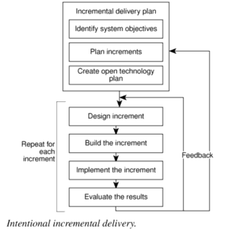
Intentional incremental delivery
Roger Du@SEI of ECNU

Slide 48
增量式交付
软件概念
需求分析
构架设计
增量式阶段1：详细设计，编码，调试……
增量式阶段2：详细设计，编码，调试……
Roger Du@SEI of ECNU

Slide 49
增量式交付的优点
增量式交付的优点是项目结束交付全部成果前，分阶段将有用的功能交付给用户。
增量式交付的主要缺点是，如果管理层面和技术层面上缺乏仔细的规划，工作就无法进行。
使用增量式交付的注意点是：
  必须确定每一增量式的交付是对用户有用的
  必须确保考虑了不同产品组成部分的技术依赖关系
Roger Du@SEI of ECNU

Slide 50
面向进度的设计
类似于增量式交付，但是面向进度的设计生命周期模型在开始的时候不必知道究竟能达到何目标，但是要确保最后的期限。
该模型的关键是要按优先级别划分系统特性并规划开发阶段，保证前面的阶段具有高优先级的特性，低特性具有低优先级别。
是否采用这种方法决定于你是否对系统目标具有足够的信心，如果有信心，则没必要采用这种方法。
Roger Du@SEI of ECNU

Slide 51
渐进交付
渐进交付是一种跨越了渐进原型和增量式交付两种模型的过程模型。
基本过程：开发一个产品的版本，展示给用户，根据反馈改善产品。
如果计划满足用户的绝大部分需求，渐进交付与渐进原型差不多，如果计划满足少量的需求，渐进交付就和增量式交付差不多。
渐进原型，强调的是系统看得见的样子，再回来堵漏洞，渐进交付中，最初的重点是系统核心和底层系统功能。
Roger Du@SEI of ECNU

Slide 52
渐进交付
软件概念
需求分析
交付最终版本
构架和内核设计
开发一个版本
并入用户反馈
交付该版本
开发一个版本
Roger Du@SEI of ECNU

Slide 53
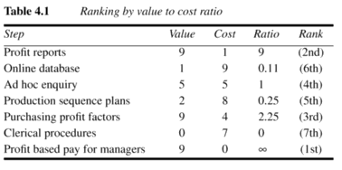
确定渐进交付目标的一种方法
价值成本比
Roger Du@SEI of ECNU

Slide 54
面向开发工具的设计
只在现有软件工具直接支持的情况下增强产品的功能，如果它不支持，就放弃这些功能。
当时间成为主要约束时，采用该模型能够比其他模型能够更完整地实现功能。
该方法的缺点是你失去了很多对产品的控制能力。
Roger Du@SEI of ECNU

Slide 55
敏捷方法（Agile Methodologies）
Extreme Programming (XP)
Scrum
Crystal
Dynamic Software Development Method (DSDM)
Feature Driven Development (FDD)
Agile Unified Process (AUP)
Roger Du@SEI of ECNU

Slide 56
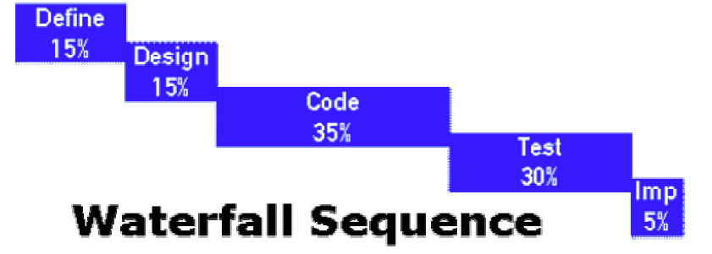
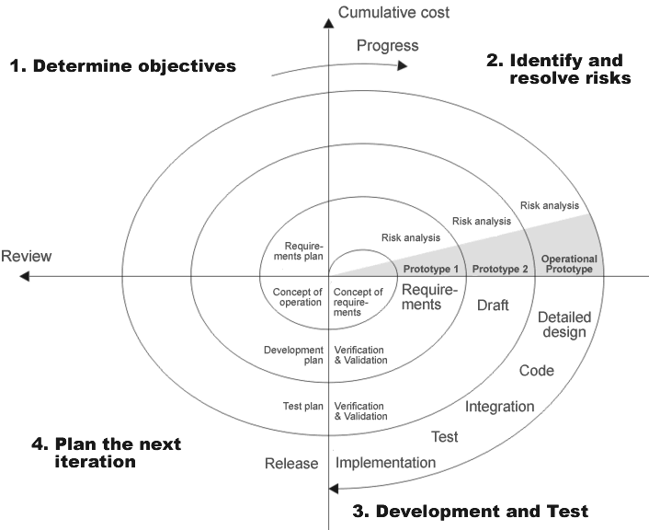
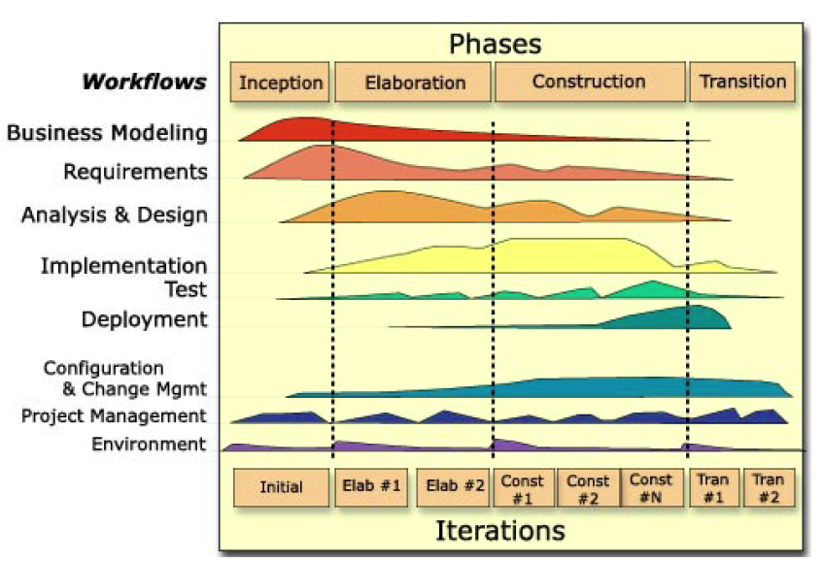
重量级（Heavyweight Methodologies）
Waterfall Process
Spiral Model
Unified Process

Slide 57


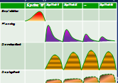



敏捷与重量级（Agile vs. Heavyweight）
Heavyweight(CMM)
Agile
Scope
Scope
(Fixed)
Scope drive the budget and schedule
Project Triple Constrain
Scope is driven by the budget and schedule
Time
Cost
Time
(Fixed)
Cost
(Fixed)
Requirement
Waterfall
Lifecycle
Iterative
Design
Programming
Testing
“Theoretical”
Fully defined processes
Software Engineering
“Empirical”
Adaptive black box
Software Craftsmanship
Process
Notes:
“Theoretical” Fully defined processes，Software Engineering“理论”完全定义的过程，软件工程
“Empirical” Adaptive black box，Software Craftsmanship“经验”自适应的黑盒子，软件工匠精神

Slide 58
核心价值和原则（Core Value and Principle）
Processes and Tools
Comprehensive Documentation
Contract Negotiation
Following a Plan
Individuals and Interactions over
Working Software over
Customer Collaboration over
Responding to Change over
Agile Adoption Scope
Recommend | Not Recommend
Requirement is volatile Devs are responsible and positive User can participate and easily engaged | Team member are more than 50 Scope is fixed
Notes:
Requirement is volatile， Devs are responsible and positive， User can participate and easily engaged
需求是不稳定的，开发者是有责任心和积极的，用户可以参与和容易参与

Slide 59
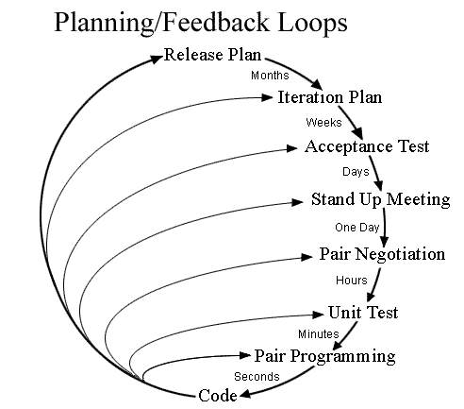
XP (Extreme Programming)
4 Simple Values:
    Simplicity
    Communication
    feedback
    courage
12 Core Practices
    Planning Game
    Small Releases
    Customer Acceptance Tests
    Simple Design
    Pair Programming
    Test Driven Development
    Refactoring
    Continuous Integration
    Collective Code Ownership
    Coding Standards
    Metaphor
    Sustainable Pace可持续的步调
Notes:
XP, originally described by Kent Beck, has emerged as one of the most popular and controversial agile methods. XP is a disciplined approach to delivering high-quality software quickly and continuously. It promotes high customer involvement, rapid feedback loops, continuous testing, continuous planning, and close teamwork to deliver working software at very frequent intervals, typically every 1-3 weeks.
The original XP recipe is based on four simple values – simplicity, communication, feedback, and courage – and twelve supporting practices:
Planning Game
Small Releases
Customer Acceptance Tests
Simple Design
Pair Programming
Test-Driven Development
Refactoring
Continuous Integration
Collective Code Ownership
Coding Standards
Metaphor
Sustainable Pace
Don Wells has depicted the XP process in a popular diagram.
In XP, the “Customer” works very closely with the development team to define and prioritize granular units of functionality referred to as "User Stories". The development team estimates, plans, and delivers the highest priority user stories in the form of working, tested software on an iteration by iteration basis. In order to maximize productivity, the practices provide a supportive, lightweight framework to guide a team and ensure high-quality software.

Slide 60

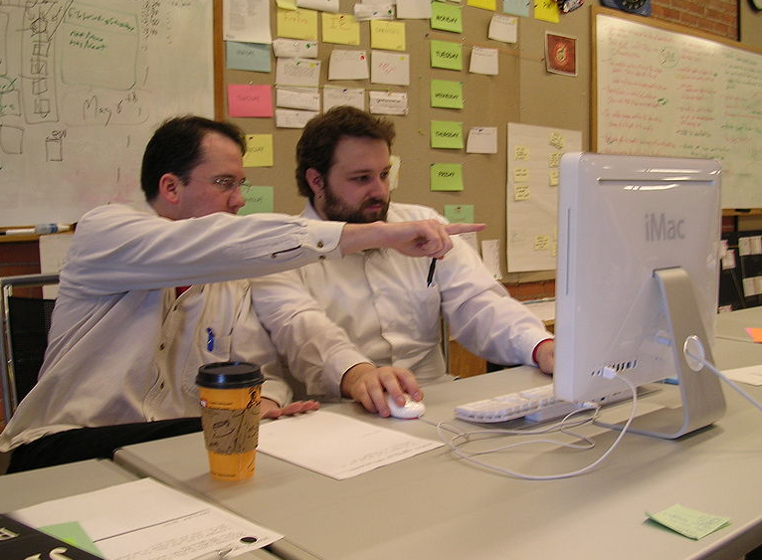
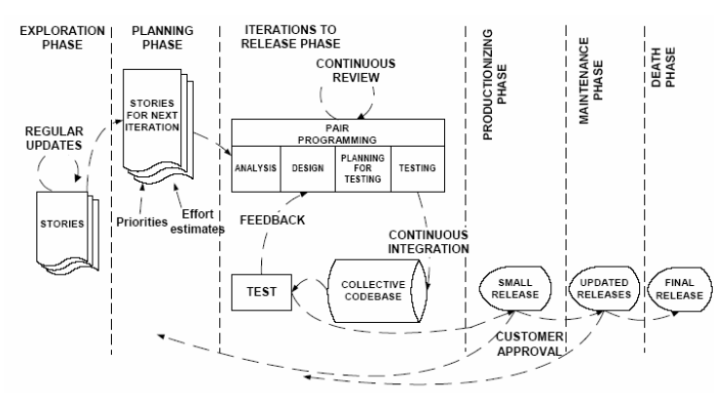
XP (Extreme Programming)
XP development Process
    The whole process
    Iteration Process
    Code Sharing Programming
  The practice and improvement of XP
Notes:
The lifecycle of an XP project, shown in Figure 4 [9], is divided into six phases: Exploration, Planning, Iterations to release, Production, Maintenance and Death.
In the Exploration phase, the customer writes out the story cards they wish to be included in their program. This leads to Planning phase where a priority order is set to each user story and a schedule of the first release is developed. Next in the Iterations to Release phase, the development team first iteration is to create a system with the architecture of the whole system then continuously integrating and testing their code. Extra testing and checking of the performance of the system before the system can be released to the customer is done in the Production phase. Postponed ideas and suggestions found at this phase are documented for later implementation in the updated releases made at the Maintenance phase. Finally the Death Phase is near when the customer have no more stories to be implemented and all the necessary documentation of the system is written as no more changes to the architecture, design or code is made.
The criticism to XP includes:
XP almost has no documents
XP only emphasis share and co-work, but instead another important factor which is also very important in our human society - competition is not involved in.
So an alternative way is provided by many XP practitioner

Slide 61
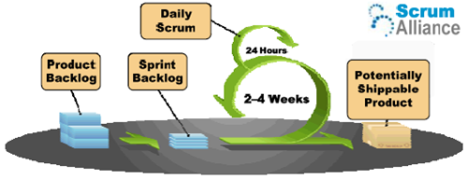
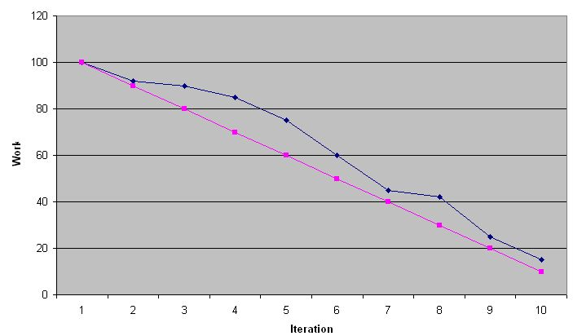
Scrum
Not SCRUM!
3 Roles
    Product Owner
    Scrum Master
    Team Member(5~9 members)
  3 Artifacts
    Product Backlog
    Sprint Backlog
    Burndown Chart
–Scrum in Rugby
Notes:
Scrum is an iterative, incremental process for developing any product or managing any work. Scrum concentrates on how the team members should function in order to produce the system flexibility in a constantly changing environment. At the end of every iteration it produces a potential set of functionality. The term ‘scrum’ originated from a strategy in the game of rugby where it denotes “getting an out-of-play ball back into the game” with teamwork
· Product Owner—The Product Owner is responsible for representing the customer or user of the product the team is building. Ideally this is the actual customer, but when the customer is not available for a project, this role is filled by someone representing the customer's interests; he or she is also responsible for being the liaison between the project team and the customer.
· Scrum Master—Scrum originated as a way to deal with troubled or emergency projects. The person brought in to refocus the project team is called a Scrum Master. This role is primarily to facilitate, report, and focus the team on the highest priority work and to remove any roadblocks that may impede team progress. Certification training for Scrum Masters exists, supporting three different levels of practice.
· Team Member—All other members of the team are considered general team members. This includes developers, architects, project managers, testers, database administrators—everyone. The team concept is important to Scrum and only the key roles of Scrum Master and Product Owner are called out. Scrum uses the term “backlog”（未办完事项） to refer to a list of items that are related. Three backlogs are defined by the Scrum process: product backlog, release backlog, and sprint backlog.
There is another item related to Backlogs that is key to Scrum. The Burndown Chart (see Figure 2) is used to indicate the number of remaining Sprint Backlog items yet to be completed in the current Sprint. A daily record is maintained showing the team's progress in achieving the goal of the Sprint
A Scrum Burndown Chart helps to provide visibility of the progress of the team and the work remaining. The straight line represents an ideal iteration where work is completed in a perfectly steady and evenly distributed manner. The more erratic line represents the work that is actually completed over time by the team.

Slide 62
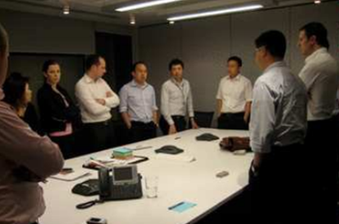
Scrum
    5 Key Ceremonies（仪式）
    Sprint
    Sprint Planning
    Daily Scrum Meeting
    Sprint Review
    Sprint Retrospective（回顾）
What did I do since the last Scrum meeting?
What do I plan on doing between now and next Scrum Meeting?
Do I have any roadblocks?
Notes:
Every day at the same time, the project team meets to discuss the project. Members are expected to stand during the entire meeting to encourage short meetings. Meetings are targeted to complete in 10 to 15 minutes. Each member in turn answers three questions:
What did I do since the last Scrum meeting?
What do I plan on doing between now and the next Scrum meeting?
Do I have any roadblocks?
This report is not a status meeting. In other words, team members do not report on what percent a task is done. They report on what work they did, why it was being done, and whether it has been completed or not. When something is encountered that is impeding progress, it is considered a roadblock. As roadblocks are reported, the team decides how to handle them, including escalating them immediately to the appropriate channel.
At the end of a Sprint, the team meets with any interested stakeholders to demonstrate what work has been completed, and to evaluate priorities for the next Sprint. In addition, any outstanding roadblocks are also discussed, as well as their impact and possible solutions.

Slide 63
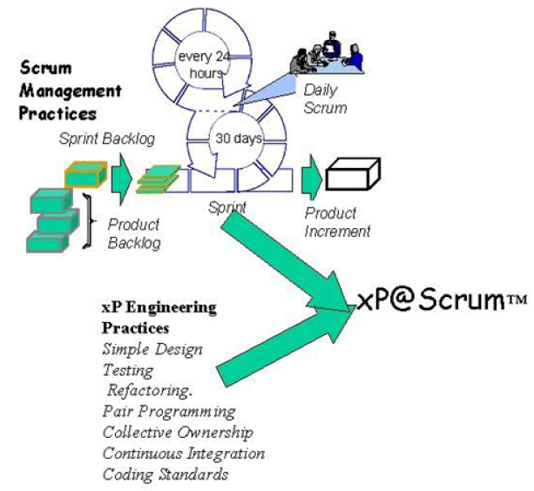
Scrum
    The practice and the improvement of Scrum
      Improve the efficiency
        6 times compare with
        tradition one –Capers Jones
      Restriction:
        not best approach for
        large, complex team structures
      Latest practice: learn from XP
        XP@ Scrum
Notes:
The Scrum process may change the job description and customs of the Scrum project team considerably. For example, the project manager, i.e. the Scrum Master, does no longer need to organize the team but the team organizes itself and makes decisions on what to do. Ken Schwaber illustrates, “Most management is used to directing the project, telling the team what to do and then ensuring they do it. Scrum relies on self-organization, with the team deciding what to do while management runs interference and removes roadblocks” [11]. Scrum has been successfully used over thousands of projects in 50 organizations producing significant productivity improvement [14]. Rising and Janof [12] suggest that “Clearly, Scrum is not an approach for large, complex team structures, but we found that even small, isolated teams on a large project could make use of some elements of Scrum. This is true process diversity”. Recently, efforts have been made to combine XP practices with Scrum project management framework to form an integrated package for software development team [11].However more study is needed to support this package.

Slide 64
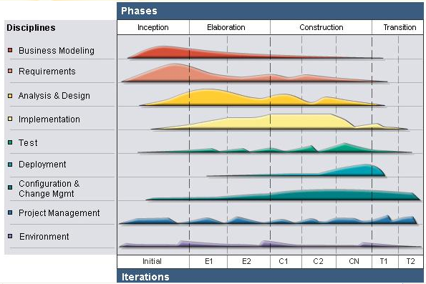
AUP (Agile Unified Process)
Unified Process (UP) & RUP
4 major phase of UP project:
    Inception
    Elaboration
    Construction
    Transition
AUP is an implementation of the Unified Process which tailors it by selecting only seven disciplines (model, implementation, test, deployment, configuration management, project management, and environments).
Notes:
AUP is an implementation of the Unified Process which tailors it by selecting only seven disciplines (model, implementation, test, deployment, configuration management, project management, and environments).

Slide 65
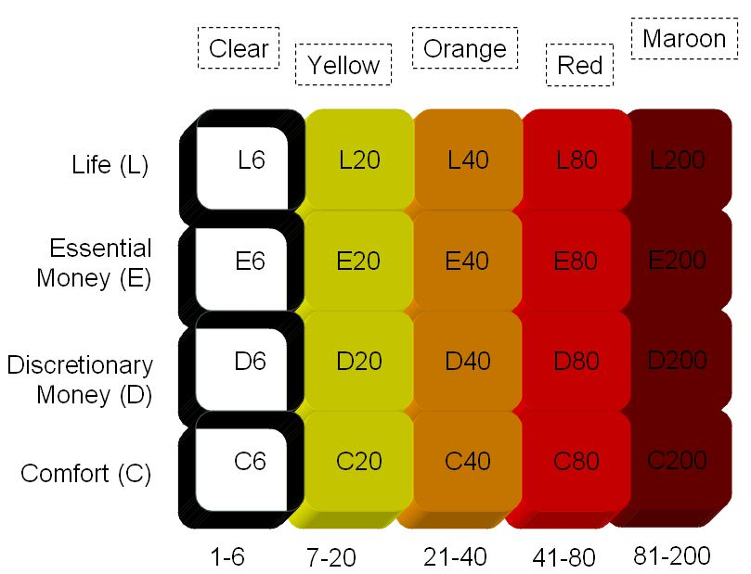
Crystal
Comprised of a family of methodologies:
Crystal Clear, Crystal Yellow, Crystal Orange, etc. - Alistair Cockburn
As the project size increases (moves to the right of the diagram), the harder the project, and hence a more comprehensive (darker color) of Crystal is necessitated.
As the criticality of a project increases (moves from the bottom to the top of the diagram), aspects of the methodology need to be put in place to accommodate the additional requirements, including the artifacts generated by the team; however criticality does not affect the color of Crystal used.
Notes:
Crystal introduces the importance of people and communications, and adjusting the techniques used in a project to the characteristics of that particular project. While other software development methods, particularly other agile methods, do stress the importance of people, the Crystal family uses a focus on people and communications as its organizing principle, and most of the properties and techniques are based on strengthening that process.
depicts how to determine which Crystal methodology to use for a project. As the project size increases (moves to the right of the diagram), the harder the project, and hence a more comprehensive (darker color) of Crystal is necessitated. As the criticality of a project increases (moves from the bottom to the top of the diagram), aspects of the methodology need to be put in place to accommodate the additional requirements, including the artifacts generated by the team; however criticality does not affect the color of Crystal used.

Slide 66
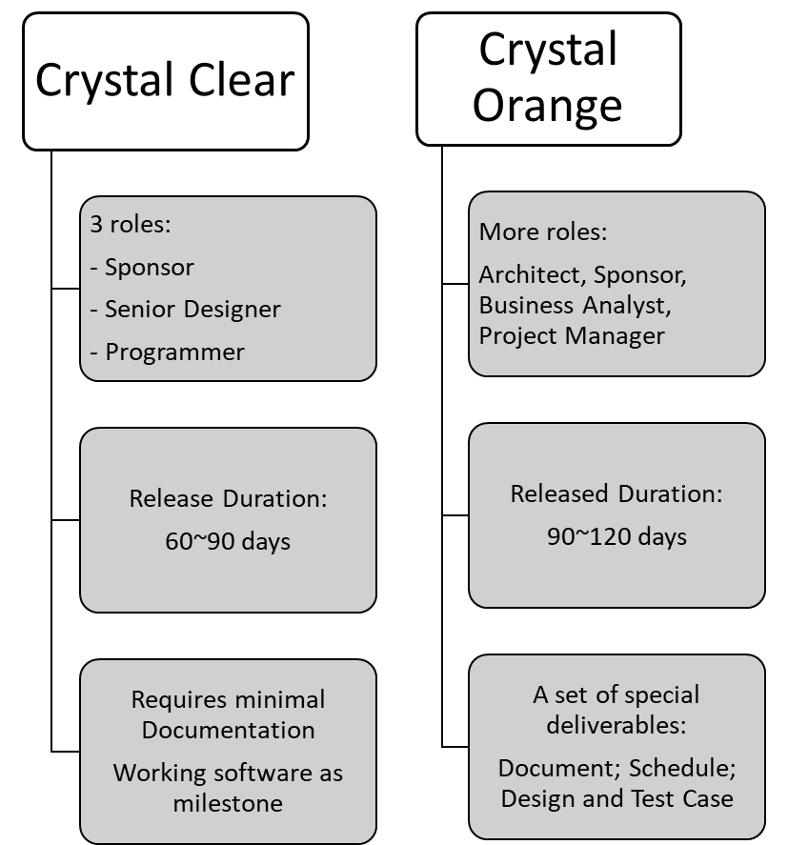
Crystal
Comparison:
Crystal Clear & Crystal Orange
The harder the project, the more comprehensive (darker color) of Crystal is necessitated
Notes:
Roles vary across the Crystal methodologies as the size and criticality of the project increases. In other words, Clear has the fewest defined roles and Maroon has the most.

Slide 67
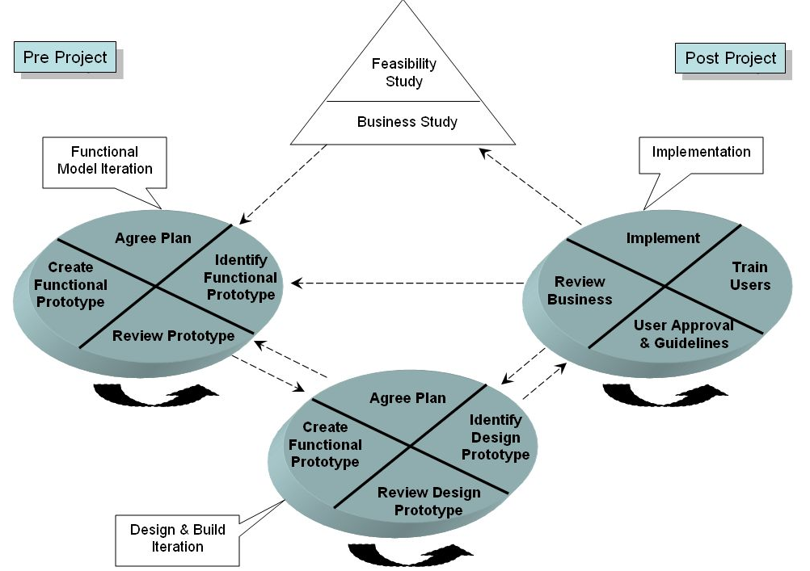
Dynamic Systems Development Method (DSDM Atern)
The DSDM Development Process
Pre-Project
Project Lifecycle:
  Feasibility Study
  Business Study
  Functional Model Iteration
  Design And Build Iteration
  Implement/Deploy/Maintain
Post-Project - Maintenance
DSDM Lifecycle: A lot of Steps
Notes:
Dynamic Systems Development Method (DSDM) is a framework originally based upon Rapid Application Development (RAD). DSDM utilises continuous user involvement in an iterative development and incremental approach, which is responsive to changing requirements, to deliver software or other deliverables that satisfies the business requirements on time and on budget.
DSDM was developed in the United Kingdom in the 1990s by the DSDM Consortium of vendors and experts in the field of Information System (IS) development by combining their best-practice experiences. The DSDM Consortium is a non-profit, vendor independent organisation which owns and administers the framework.
Feasibility Study - Finding out if and how the project will work out
Business Study - Studying the business aspects of the project
Pre Project: Things that need to occur before the project begins.
Project Lifecycle: The actual project occurs. This phase is broken into five stages:
Feasibility Study
Business Study
Functional Model Iteration (Exploration)
Design and Build Iteration (Engineering)
Implementation (Deployment)
Post Project Phase: Things that need to occur after the project has been completed.

Slide 68
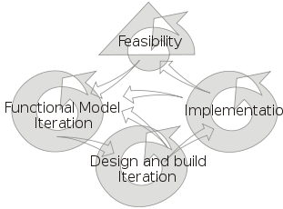
Dynamic Systems Development Method (DSDM Atern)
5 techniques in DSDM:
Iterative development
Timeboxing
MoSCoW Rules
Facilitated workshops
Modeling
MoSCoW Rules:
M – Must have requirements
S – Should have if at all possible
C – Could have but not critical
W - Won’t have this time, but potentially later
Notes:
MoSCoW is a prioritization technique used in business analysis and software development to reach a common understanding with stakeholders on the importance they place on the delivery of each requirement - also known as MoSCoW prioritization or MoSCoW analysis.
M – Must have requirements
S – Should have if at all possible
C – Could have but not critical
W - Won’t have this time, but potentially later
The DSDM project framework is independent of, and can be implemented in conjunction with, other iterative methodologies such as Extreme Programming and the Rational Unified Process.

Slide 69
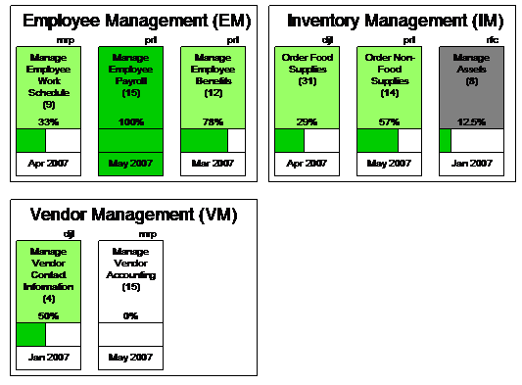
Feature-Driven Development (FDD)
Domain Model
Unified Model & Feature Set
Unit feature in FDD
    <action><result>[of|to|for|from]<object>
    --” Calculate the monthly interest rate for
    an adjustable rate mortgage”
  Specific in FDD:
    FDD describes specific, very short phases of work which are to be accomplished separately per feature. These include Domain Walkthrough, Design, Design Inspection, Code, Code Inspection, and Promote to Build.
Feature Set Progress Report:
Light green Feature Sets are in progress and on schedule, dark green Feature Sets are completed, and grey Feature Sets are behind schedule.
Notes:
While most Agile methodologies start with a handful of principles or a specific set of processes, the center of Feature Driven Development (FDD) is the domain model. Creating a model of the domain is the foundational step for FDD, which requires collecting domain knowledge from all domain experts (sometimes called Subject Matter Experts or SMEs), and integrating this knowledge into a unified model (or set of models) representing the problem domain. Once this model and any other requirements have been evaluated, a rough plan is drawn up to determine what resources will be needed to build the masterpiece.
<action><result>[of|to|for|from]<object>.
This expression can be restated as: an action, causes a result, to an object. The section in the brackets is optional to make the feature easier to read. An example of a feature is: Calculate the monthly interest rate for an adjustable rate mortgage. Here "calculate" is the <action>, "monthly interest rate" is the <result>, and "an adjustable rate mortgage" is the object participating in this feature.

Slide 70

Comparison & Overview
Manage Risk
More formal
Documents
AUP
Current Business Value
Can be
traditional Roles
DSDM
Most heavyweight
compared in agile
Prioritized Business Value
Simplicity
Scrum
Size & Criticality
Waterfall
XP
Deliver working software
in shortest time of highest value
Crystal
Family of
methodologies
Engineering
Practice
Different Project Size and
criticality, different methodology
RUP
Compensation to each other
Business Model
FDD
Individual
code ownership
Evolution not Revolution

Slide 71
Comparison & Overview
 | Strengths | Weaknesses
XP | Strong technical practices. Customer ownership of feature priority, developer ownership of estimates. Frequent feedback opportunities. Most widely known and adopted approach, at least in the U.S. | Requires onsite customer. Documentation primarily through verbal communication and code. For some teams these are the only artifacts created, others create minimal design and user documentation. Difficult for new adopters to determine how to accommodate architectural and design concerns.
Scrum | Complements existing practices. Self organizing teams and feedback. Customer participation and steering. Priorities based on business value. Only approach here that has a certification process. | Only provides project management support, other disciplines are out of scope. Does not specify technical practices. Can take some time to get the business to provide unique priorities for each requirement.
FDD | Supports multiple teams working in parallel. All aspects of a project tracked by feature. Design by feature and build by feature aspects are easy to understand and adopt. Scales to large teams or projects well. | Promotes individual code ownership as opposed to shared/team ownership. Iterations are not as well defined by the process as other Agile methodologies. The model-centric aspects can have huge impacts when working on existing systems that have no models.

Slide 72
 | Strengths | Weaknesses
AUP | Robust methodology with many artifacts and disciplines to choose from. Scales up very well. Documentation helps communicate in distributed environments. Priorities set based on highest risk. Risk can be a business or technical risk. | Higher levels of ceremony may be a hindrance in smaller projects. Minimal attention to team dynamics. Documentation is much more formal than most approaches mentioned here.
Crystal | Family of methodologies designed to scale by project size and criticality. Only methodology that specifically accounts for life critical projects. As project size grows, cross-functional teams are utilized to ensure consistency. The "human" component has been considered for every aspect of the project support structure. An emphasis on testing is so strong that at least one tester is expected to be on each project team. | Expects all team members to be co-located. May not work well for distributed teams. Adjustments are required from one project size/structure to another in order to follow the prescribed flavor of Crystal for that project size/criticality. Moving from one flavor of Crystal to another in mid project doesn't work, as Crystal was not designed to be upward or downward compatible.
DSDM | An emphasis on testing is so strong that at least one tester is expected to be on each project team. Designed from the ground up by business people, so business value is identified and expected to be the highest priority deliverable. Has specific approach to determining how important each requirement is to an iteration. Sets stakeholder expectations from the start of the project that not all requirements will make it into the final deliverable. | Probably the most heavyweight project compared in this survey. Expects continuous user involvement. Defines several artifacts and work products for each phase of the project; heavier documentation. Access to material is controlled by a Consortium, and fees may be charged just to access the reference material.

Slide 73
How to adopt these?
Condition | XP | Scrum | FDD | AUP | Crystal | DSDM
Small Team | √ | √ | X | X | - | √
Highly Volatile Requirements | √ | √ | √ | - | - | X
Distributed Teams | X | √ | √ | √ | X | X
High Ceremony Culture | X | X | - | √ | - | √
High Criticality Systems | X | - | - | - | √ | X
Multiple Customers / Stakeholders | X | √ | - | - | - | X
favor (√), discourage (X), and neutral (-)

Slide 74
商品软件
商品软件也许未必满足你所有的要求，但是自己开发也需要一个周期，到那个时候，商品软件可能已经满足了你的要求。
商品软件可能存在不足，但是，你自己开发的产品也未必那么完美，当你补充了商品软件的不足时，也许带来了新的问题。
因而，商品软件始终是一个值得考虑的方案。
Roger Du@SEI of ECNU

Slide 75
一个有趣的比喻
晚餐菜单
欢迎光临过程模型选择咖啡厅，希望您好胃口
正餐
螺旋模型
手制烤鸡，外配风险减少调味料
15.95美元
渐进交付模型
用水拌成的增量式交付及渐进原型
15.95美元
Roger Du@SEI of ECNU

Slide 76
增量式交付模型
五门课程酒席，详情请问服务员
14.95美元
面向进度的设计
各种方法学，特别适合于快速运作
11.95美元
纯瀑布模型
按经典的原有菜谱制作
14.95美元
Roger Du@SEI of ECNU

Slide 77
色拉
面向工具的设计
填鸭内填各种豆角
时价
商用软件
名厨手艺，每日变动
4.95美元
编码及查错
大碗面
整日供应
5.95美元
Roger Du@SEI of ECNU

